Slide 1
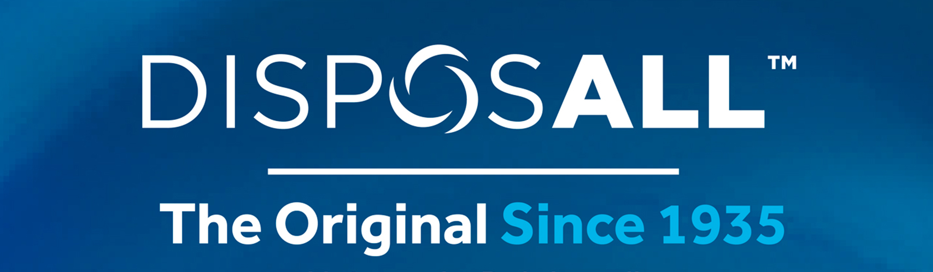
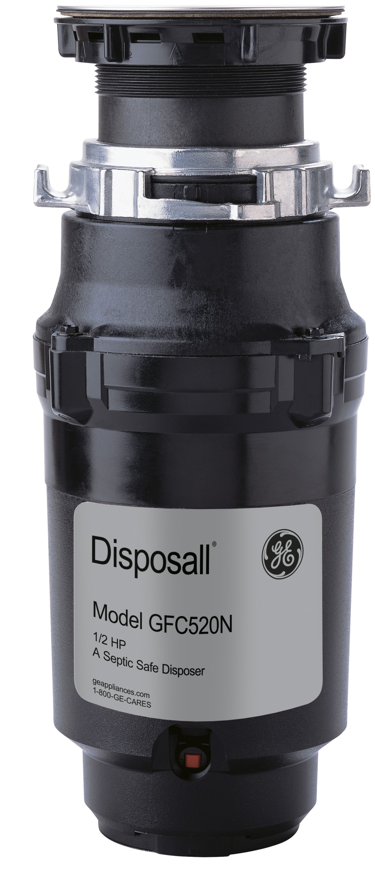


No Tool Needed
Finer Grind
Septic Safe
Drain Boost Technology

